Slide 1
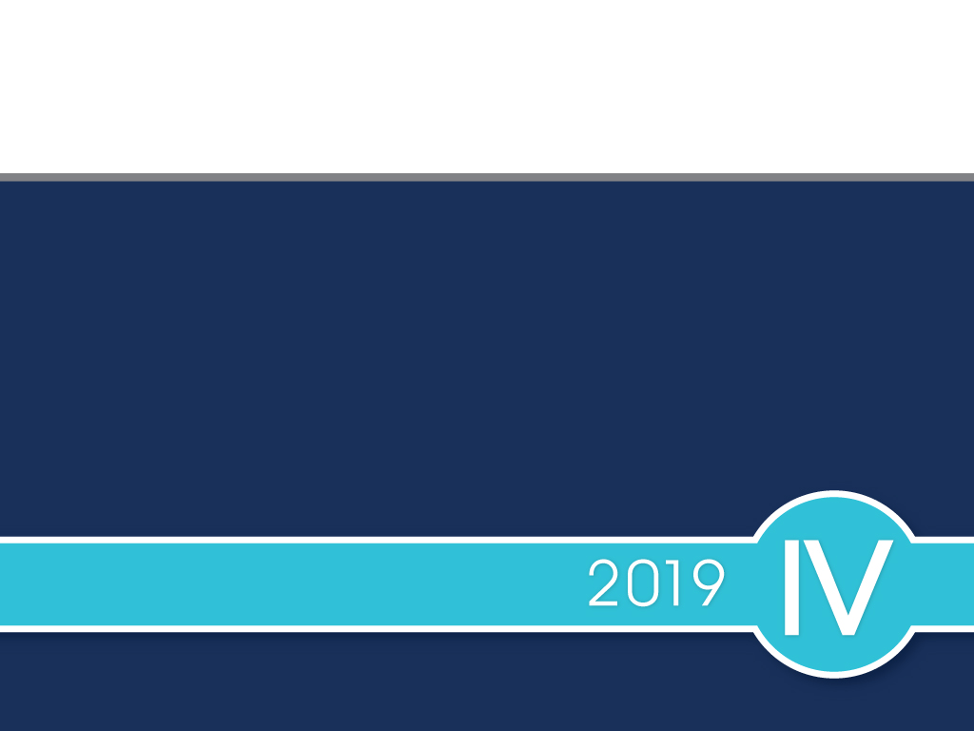
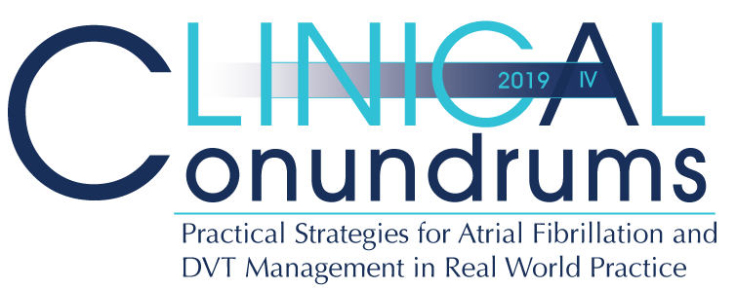

Slide 2

Presenter Disclosure
Presenter - [presenter name]
Relationships with financial sponsors:
Grants/Research Support:
Speakers Bureau/Honoraria:
Consulting Fees:
Patents:
Other:
Notes:
Speaker Notes:

Slide 3
Disclosure of Financial Support
This program has received financial support from BMS and Pfizer Alliance Canada in the form of an educational grant.
This program has received in-kind support from BMS and Pfizer Alliance Canada in the form of logistical support.
Potential for conflict(s) of interest:
[Presenter] has received [payment/funding, etc.] from [organization supporting this program AND/OR organization whose product(s) are being discussed in this program].
BMS and Pfizer Alliance Canada Canada developed, licenses, distributes and benefits from the sale of a product that will be discussed in this program
Notes:
Speaker Notes:

Slide 4
Mitigating Potential Bias
The Canadian Heart Research Centre (CHRC) assesses conflict of interest with its instructors, planners, managers and other individuals who are in a position to control the content of CME activities. All relevant conflicts of interest that are identified are thoroughly vetted by the CHRC for fair balance, scientific objectivity of studies utilized in this program, and patient care recommendations. The CHRC is committed to providing its learners with high quality CME activities and related materials that promote improvements or quality in healthcare and not a specific proprietary business interest of a commercial interest.
The speaker had provided a full disclosure in advance of the program. The scientific content of the program is evidence based and all content related to pharmacotherapy is within product label. The program has been peer reviewed and is nationally accredited by the College of Family Physicians of Canada.
[Presenter] has provided his disclosure information at the start of this presentation.
Notes:
Speaker Notes:

Slide 5

Program Development
This program was planned by the Canadian Heart Research Centre, a not-for-profit academic organization to achieve scientific integrity, objectivity, and balance.
This program has received an educational grant and in-kind support from BMS and Pfizer Alliance Canada
Notes:
Speaker Notes:

Slide 6
Steering Committee
George Honos, MD Clinical Conundrums Program Chair
Cardiologist Chief of cardiology Medical Director of CV Program, CHUM Associate Professor of Medicine, Université de Montréal Montreal, Quebec
Jacques Bouchard MD
Associate professor of clinical medicine
Université Laval , Québec
Head medicine department
Hôpital de la Malbaie . Québec
Paul Dorian, MD Cardiologist Director, Division of Cardiology Professor of Medicine St. Michael's Hospital University of Toronto Toronto, Ontario
Indy (Indraneel) Ghosh, MD
Assistant Clinical Professor, McMaster University
Emergency Physician at Trillium Health Partners
Shaun Goodman, MD
Associate Head, Division of Cardiology, St. Michael's Hospital
Professor and Heart & Stroke Foundation of Ontario (Polo) Chair, Department of Medicine, University of Toronto
Adjunct Professor, Department of Medicine, University of Alberta
Jeffrey Habert, MD
Family Physician Assistant Professor
University of Toronto
Dept. of Family and Community Medicine Toronto, Ontario
Sylvain Lanthier, MD
Neurologist Neurovascular Program, CHUM
Associate Professor, University of Montreal Montreal, Quebec
John K. Marshall, MD
Professor of Medicine, and
Director, Division of Gastroenterology
McMaster University
Hamilton Ontario
L. Brent Mitchell, MD
Cardiac Electrophysiologist
Professor, Department of Cardiac Sciences
Libin Cardiovascular Institute of Alberta
University of Calgary Calgary, Alberta
Daniel Ngui, MD
Family Physician Clinical Lead, Fraser Street Medical
Clinical Associate Professor
UBC Department of Family Medicine Vancouver, British Columbia
Isabelle Noiseux, MD
Directrice adjointe à la direction de la formation professionnelle
FMOQ
Faisal Rehman, MD
Professor of Medicine
Schulich School of Medicine
Western University
Notes:
Speaker Notes:

Slide 7

Learning Objectives
Upon completion of this activity, participants should be able to:
I
Select personalized treatment options for stroke prevention in atrial fibrillation using current Canadian Practice Guidelines supplemented with reassuring “Real World” experience
II
Assess and optimize bleeding risk of atrial fibrillation patients requiring long-term DOAC stroke prevention treatment
III
Recognize the current treatment gap in Canada and take steps at ensuring appropriate dosage selection and long-term compliance with oral anticoagulation among AF patients

Slide 8

1 in 3 strokes after age 65 are attributed to AF
20% of patients die and another 60% have major disability after an embolic stroke
Despite anticoagulation being an effective treatment in AF, stroke prevention is slow to reflect evidence-based practice.
Real-world data reveal that a substantial portion of AF patients who would benefit from anticoagulation do not receive it adequately.
A large part of this suboptimal treatment is due to the underutilization and incorrect dosing of direct oral anticoagulants (DOACs).
Canadian Journal of Cardiology 34 (2018) 1412e1425
Notes:
Speaker Notes:

Slide 9
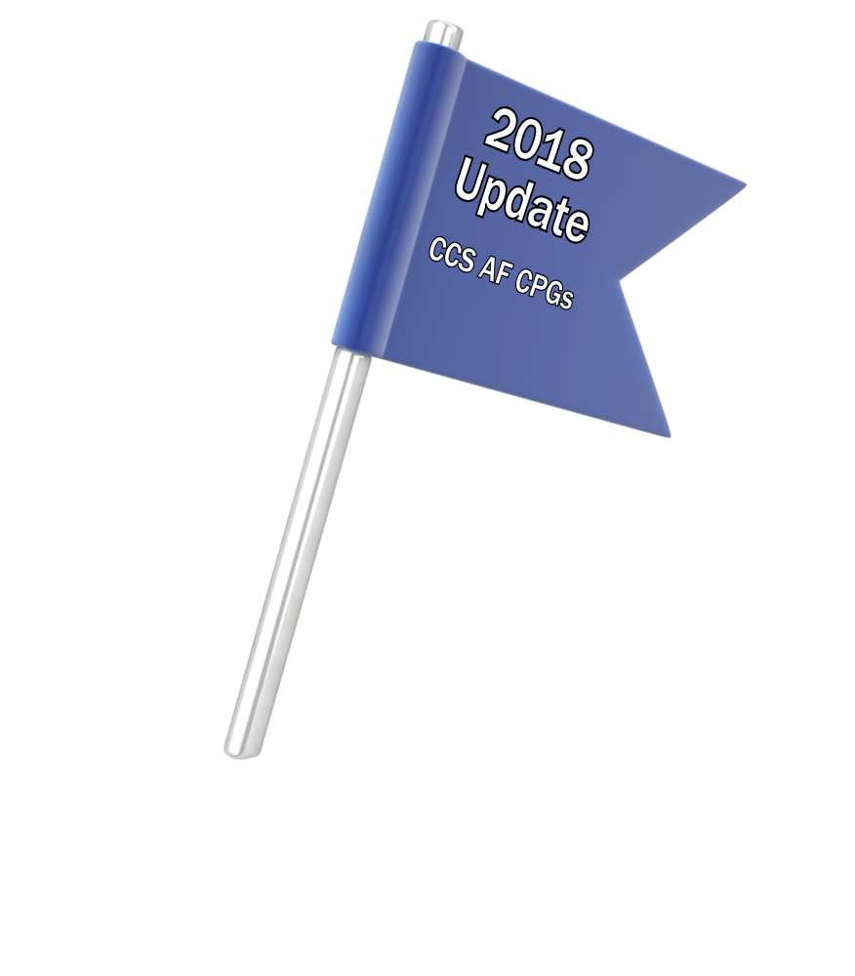
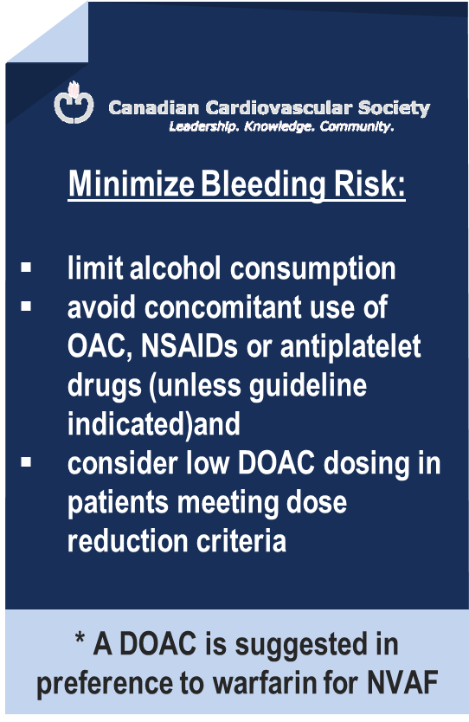
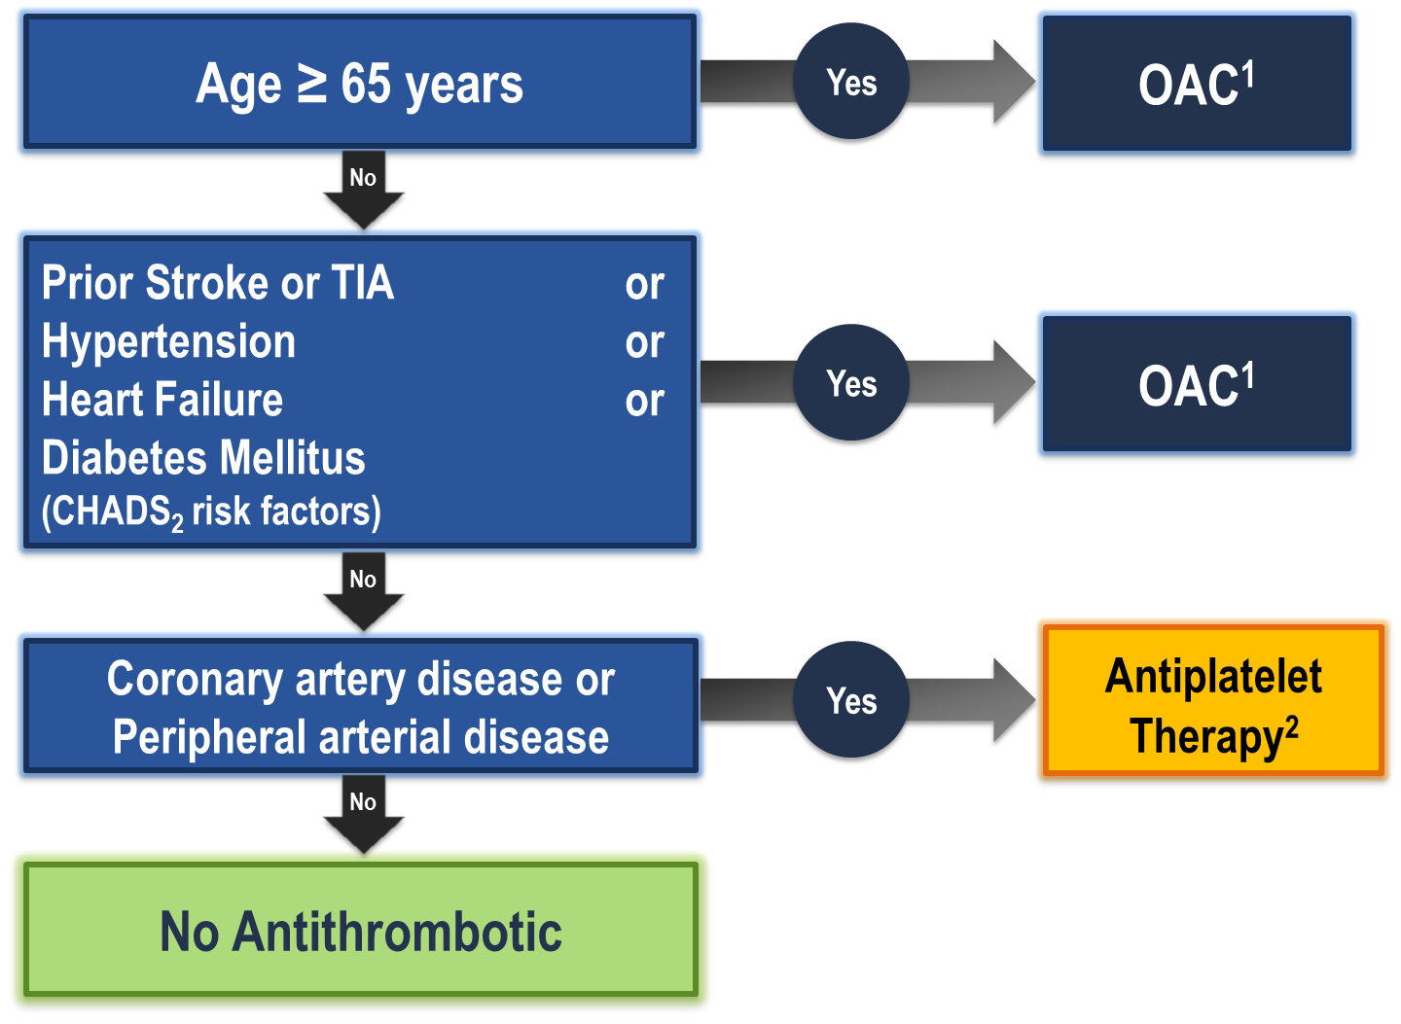
The “CCS Algorithm” (CHADS-65) for OAC Therapy in AF
¹ A DOAC is preferred over warfarin in non-valvular AF
² Therapeutic options include single antiplatelet therapy (ASA 81-100 mg daily) alone; or in combination with either a second antiplatelet agent (e.g. clopidogrel 75 mg daily or ticagrelor 60 mg BID), or an antithrombotic agent (rivaroxaban 2.5 mg BID)
Andrade JG et al. Can J Cardiol 2018;34:1371-1392
CCS AF Guidelines. Can J Cardiol. 2016; 32: 1170-1185
Notes:
Speaker Notes:
This is the new and important slide from the 2018 (box to the right is from the 2016 update) Canadian AF guidelines update.
Two key points to emphasize: the (*) indicates that a DOAC should be selected in preference to an AVK for anticoagulation. The shaded box to the right emphasizes that all efforts should be made to select the correct DOAC dosage based on age, size and renal function as well as to minimize the bleeding risk by addressing any modifiable bleeding risk factors present.
There is no longer any need to calculate a patient’s HASBLED score as this does not influence management (most patients are antioagulated even, if at higher bleeding risk..)
Canada has not adopted the CHADSVASC scoring system to determine eligibility for oral anticoagulation in AF. The annual embolic stroke risk threshold for anticoagulation is set at 1.5% and it is felt that a vascular diseased patient who is aged 64 or less and CHADS2 = 0 has an annual stroke risk of less than 1.5% based on the Canadian Guideline Committee’s interpretation of currently available large data sets.

Slide 10
Operational Definition of Non Valvular Atrial Fibrillation (NVAF)
“Valvular” AF includes :
Mechanical heart valve
Rheumatic moderate or severe mitral valve stenosis (MS) *
NVAF (“ non-valvular” AF) therefore includes :
Mitral regurgitation (MR)
Aortic stenosis (AS)
Aortic insufficiency (AI)
Remote (3-6 months) tissue prosthetic heart valve
Remote (3-6 months) surgical valve repair
* It is uncertain whether patients with only mild MS or post mitral commissurotomy should be regarded as “Valvular” AF.
Macle L et al. Can J Cardiol 31:1207-18, 2015
De Caterina R, et al. Eur Hear J 2014;35:3328-35
Notes:
Speaker Notes:
MDs need to be reminded that NVAF applies to patients WITHOUT a mechanical heart valve prosthesis OR rheumatic mitral valve disease (a relative rarity in Canada these days). Patients with ALL other forms of valvular heart disease, including valvular bioprostheses, qualify as NVAF!

Slide 11
DOACs vs Warfarin RCTs Baseline Characteristics
 | RE-LYª ^{(Dabigatran)} | ROCKET-AF^{b} ^{(Rivaroxaban)} | ARISTOTLE^{c} ^{(Apixaban)} | ENGAGE AF^{d} ^{(Edoxaban)}
Randomized, N | 18,113 | 14,264 | 18,201 | 21,105
Age, y | 72±9 | 73 [65-78] | 70 [63-76] | 72 [64-78]
Female, % | 37 | 40 | 35 | 38
Paroxysmal AF, % | 32 | 18 | 15 | 25
VKA naive, % | 50 | 38 | 43 | 41
Aspirin use, % | 40 | 36 | 31 | 29
CHADS 2
0-1
2
3-6
Connolly SJ, et al. N Engl J Med. 2009;361:1139-1151^{[3];}
Patel MR, et al. N Engl J Med. 2011;365:883-891^{[4];}
Granger CB, et al. N Engl J Med. 2011;365:981-992^{[5];}
Giuliano RP, et al. N Engl J Med. 2013;369:2093-2104.^{[6}
Notes:
Speaker Notes:
Over 70,000 patients have been prospectively studied with the different DOACs compared to warfarin (but not to each other.
Average age was over 70 in each trial (AF is an arrhythmia of the elderly). Co-morbidities and therefore treatment conundrums are very common!
Women represented up to 40% of subjects randomized in these trials (for once well represented with results applicable to them)!
ASA use was allowed in each trial if indicated according to the investigator (up to 40% of patients were on concomitant ASA). This allows us to see the important effect of ASA+DOAC or ASA+ warfarin on bleeding risk and underscores the importance of stopping ASA (and NSAIDs) whenever possible when prescribing a DOAC
The trials randomized AF patients with a broad range of annual stroke and systemic embolism risk based on their CHADS2 score. Two of the four trials randomized patients at lower CHADS2 0-1 risk wjile the other two focused on AF patients at higher annual risk. This has clear implications when attempting to compare efficacy and safety results of DOACs vs warfarin using indirect comparisons and meta-analyses.

Slide 12
DOACs as Compared to Warfarin Indirect Comparisons from the Clinical Trials
 | Apixaban¹ | Dabigatran 110² | Dabigatran 150² | EDOXABAN 60 | Rivaroxaban³
Stroke/SE
Major Bleed
Intracranial Bleed
GI Bleed
All Cause Death
To date there are no head-to-head trials between apixaban, dabigatran, edoxaban and rivaroxaban, therefore comparative efficacy and safety have not been established
Significant Increase
Significant Reduction
Non Significant Difference
Granger et al., NEJM 2011; 365: 981-992
Connolly et al., NEJM 2009; 361: 1139-1151
Patel et al., NEJM 2011; 365: 883-891
Giuliano RP et al NEJM 2013; 369:2091
Notes:
Speaker Notes:
This slide shows some key efficacy and safety outcome data vs. warfarin from the four major DOAC trials: RE-LY, ROCKET, ARISTOTLE and ENGAGE
Apixaban and Dabigatran 150 mg were associated with significant reduction of stroke/SE vs. warfarin.
Apixaban, Dabigatran 110 mg and Edoxaban were associated with significant reduction of major bleeding vs. warfarin.
All DOACs were associated with a significant reduction of intracranial bleeding (ICH) compared to warfarin.
Dabigatran 150 mg, Edoxaban and Rivaroxaban were associated with an increase in GI bleeding vs. warfarin.
Apixaban is associated with a significant reduction in mortality compared to warfarin.
Definition of major bleeding:
RE-LY: a reduction in the hemoglobin level of at least 20 g per liter, transfusion of at least 2 units of blood, or symptomatic bleeding in a critical area or organ.
ROCKET: as clinically overt bleeding associated with any of the following: fatal outcome, involving a critical site (i.e., intracranial, intraspinal, intraocular, pericardial, intraarticular, intramuscular with compartment syndrome, or retroperitoneal), or clinically overt bleeding associated with a fall in hemoglobin concentration of ≥ 2 g/dL, or leading to transfusion of ≥ 2 units of packed red blood cells or whole blood.
ARISTOTLE: clinically overt bleeding accompanied by a decrease in the hemoglobin level of at least 2 g per deciliter or transfusion of at least 2 units of packed red cells, occurring at a critical site, or resulting in death.
ENGAGE: International Society of Thrombosis and Hemostasis definition : clinically overt bleeding accompanied by a decrease in the hemoglobin level of at least 2 g per deciliter or transfusion of at least 2 units of packed red cells, occurring at a critical site, or resulting in death.
References:
﻿Connolly SJ, et al; for the RE-LY Steering Committee and Investigators. Dabigatran versus warfarin in patients with atrial fibrillation. N Engl J Med 2009; 361:1139-1151.
Connolly SJ, et al; for the RE-LY Investigators. Newly identified events in the RE-LY trial. N Engl J Med 2010; 363(19):1875-1876.
Patel MR, et al; and the ROCKET AF Steering Committee for the ROCKET AF Investigators. Rivaroxaban versus warfarin in nonvalvular atrial fibrillation. N Engl J Med 2011; 365:883-891.
Granger CB, et al; for the ARISTOTLE Committees and Investigators. Apixaban versus warfarin in patients with atrial fibrillation. N Engl J Med 2011; 365:981-992.

Slide 13
Stroke Prevention in AF: Clinical Pharmacology and Dosing of DOACs
 | Apixaban | Dabigatran | EDOXABAN | Rivaroxaban
Mechanism of action | Direct Factor Xa inhibitor | Direct thrombin inhibitor | Direct Factor Xa inhibitor | Direct Factor Xa inhibitor
Oral bioavailability | ~50% | ~6.5% | 62% | 80-100%
Pro-drug | No | Yes | No | No
Food effect | No | No | No | Yes (needs to be taken with food)
Renal clearance | ~27% | 85% | 50% | 36% *
Mean half-life (t_{1/2}) | ~12 h | 11-17h | 10-14h | 5-13 h
T_{max} | 3-4 h | 0.5-2 h | 1-2h | 2-4 h
Recommended daily dose | 5 mg BID | 150 mg BID | 60 mg QD | 20 mg QD
Pfizer Canada Inc./BMS Canada. Eliquis (apixaban) Product Monograph, June 16, 2016.
Boehringer Ingelheim Canada Ltd. Pradaxa (dagbatran) Product Monograph. August 11, 2016.
Bayer Inc. Xarelto (rivaroxaban) Product Monograph. July 20, 2015.
Daiichi Sankyp Inc. Lixiana (edoxaban) Product Monograph. November 2, 2016.
* Rivaroxaban is 66% renally cleared and its active metabolite is 36% renally cleared
Notes:
Speaker Notes:
DOACs can be differentiated based on efficacy and bleeding risk in the clinical trials ( and real-world experience available and forthcoming…) with the limitations of indirect clinical comparisons duly acknowledged. DOACs can also be differentiated based on other factors as summarized in this slide. Parameters such as borderline renal function, sensitivity to dyspepsia, irregular food intake, need for blister pack medication preparation by pharmacist, cognitive dysfunction and medication non compliance to BID dosing etc etc can determine selection of the best agent for a given patient!
The Tmax of all DOACs is a short 2-4 hours. This means that, unlike with warfarin, a patient is rapidly anticoagulated within just two hours following a DOAC dose. This has important implications for heparin “bridging” which is no longer required with DOACs as well as for the timing of resumption of DOAC therapy following procedures.
All DOACs share a short 12 hour half-life in the setting of preserved renal function (CrCl > 60 ml/min). This is a major advantage over warfarin which has a half-life of 36 hours or longer depending on hepatic function. Most procedures at intermediate or high bleeding risk can be performed within 1-2 days respectively of withholding a DOAC with additional delay required with renal dysfunction. Moreover, major bleeding can usually be controlled with local and supportive measures as the effect of the DOAC wears off quickly. Specific DOAC antidotes are therefore rarely required.

Slide 14
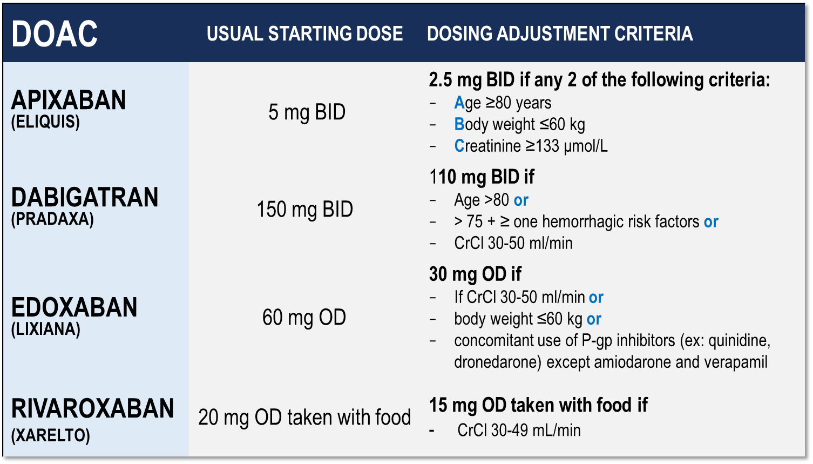
Considerations for Dosing of DOACs
Pfizer Canada Inc./BMS Canada. Eliquis (apixaban) Product Monograph, 2018.
Boehringer Ingelheim Canada Ltd. Pradaxa (dagbatran) Product Monograph. August 11, 2016.
Bayer Inc. Xarelto (rivaroxaban) Product Monograph. 2018.
Daiichi Sankyp Inc. Lixiana (edoxaban) Product Monograph. 2017.
Notes:
Speaker Notes:
Indispensable slide summarizing the criteria for a dosage adjustment from the default higher dosage for the different DOACs currently available in Canada
The dosing adjustments proposed for apixaban, edoxaban and rivaroxaban are those utilized to the dosage of selected patients enrolled in the respective prospective clinical trials (ARISTOTLE, ENGAGE and ROCKET-AF). The overall goal was to achieve a stable plasma concentration in subjects assigned to DOAC therapy in these studies.
The speaker should emphasize that the RELY study, in fact, tested two separate dosages of dabigatran (150 mg and 110 mg BID) independently against warfarin, without a pre-specified dosage reduction algorithm for reduced renal function. Since dabigatran is known to be 85% renally cleared, the Canadian AF Guidelines Committee subsequently proposed dosing adjustments (as did all other guideline committees), as listed in the table, for elderly patients and those with stage 3 renal dysfunction in order to minimize the risk of drug accumulation and bleeding in these patients.

Slide 15
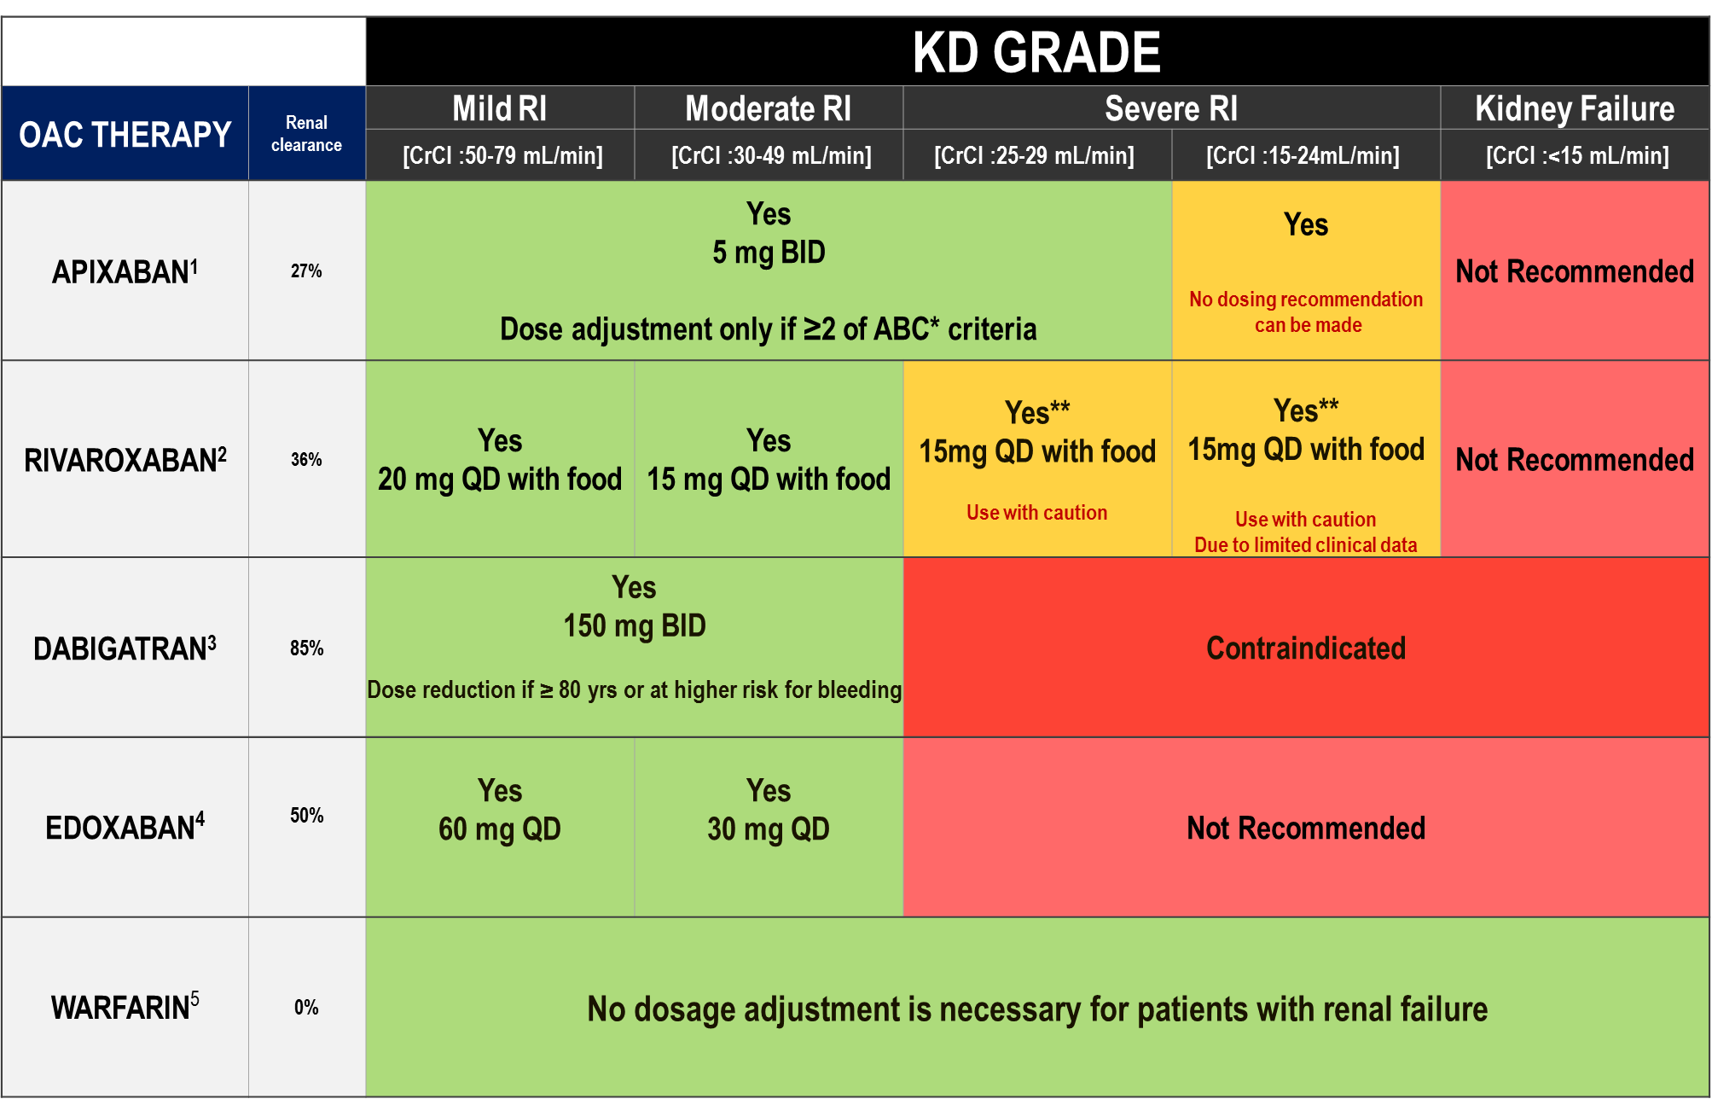
DOAC Dosing Recommendations for Stroke Prevention in AF in Patients with Renal Impairment According to the Canadian Product Monographs
Pfizer Canada Inc./BMS Canada. Eliquis (apixaban) Product Monograph, 2018.
Boehringer Ingelheim Canada Ltd. Pradaxa (dagbatran) Product Monograph. August 11, 2016.
Bayer Inc. Xarelto (rivaroxaban) Product Monograph. 2018.
Daiichi Sankyp Inc. Lixiana (edoxaban) Product Monograph. 2017.
Notes:
Speaker Notes:
*ABC criteria: Dose reduction to 2.5 mg BID if at least 2 of the following: Age ≥ 80, Body weight ≤ 60kg, serum Creatinine ≥ 133 micromol/L (1.5 mg/dL)
**Moderate renal impairment: Use with caution especially in those concomitantly receiving other drugs which increase rivaroxaban plasma concentrations, consider the benefit/risk of anticoagulant therapy before administering rivaroxaban to patients with moderate renal impairment having a creatinine clearance close to the severe renal impairment category (CrCl < 30 mL/min), or in those with a potential to have deterioration of renal function to severe impairment during therapy.
DOAC, non-vitamin K antagonist oral anticoagulant; AF, atrial fibrillation; CrCL, estimated creatinine clearance

Slide 16
DOAC Antidotes
Andexanetª ^{(PRT064445)} | Antidote for factor Xa inhibitors Recombinant protein binding to factor Xa inhibitor site
Aripazine^{b} ^{(PER977)} | Antidote for factor Xa inhibitors, direct thrombin inhibitors, low molecular-weight heparins, and fondaparinux Synthetic small molecule; reversal effect through direct binding to anticoagulant
Idarucizumab^{c} ^{(BI 655075)} | Antidote for direct thrombin inhibitors Fully humanized antibody fragment
a. Clinicaltrials,gov; NCT01758432 16; b Dolgin E. Nat Med. 2013;19:251(17), c, Clinicaltrials.gov;NCT01955720.{18}
Notes:
Speaker Notes:
Key Points:
Idarucizumab (Praxbind™) is approved in the US as well as Canada and is available for rapid dabigatran effect reversal in highly selected situations. These include emergent need for surgery (major trauma), need for thrombolysis for ischemic stroke, and suspected dabigatran overdose)
Andexanet Alpha (AndexXa™) was approved by the FDA in the US in May 2018 but is still awaiting approval by Health Canada at the present time. It is “decoy” Xa recombinant protein that binds to any of the anti-Xa DOACs (apixaban, rivaroxaban, edoxaban) thus sequestering them and interrupting their anticoagulant activity. As with Idarucizumab, a high selective usage is anticipated once approved in this country.
It is important to keep in mind that all DOAC antidotes have the potential of pro-thrombotic complications (eg. MI, ischemic stroke) that can reach a rate of 5% at one month. The benefit-risk of their use should therefore carefully be individualized.

Slide 17

What are the patterns of reduced dose use in Canada?
Notes:
Speaker Notes:

Slide 18
Appropriate Use of Antithrombotic Medications in Canadian Patients with NVAF
7,019 patients with NVAF from 735 primary care physician practices
Over 90% of patients with CHADS₂ >1 receiving oral anticoagulation
BUT ….
Over 50% of patients on OAC taking warfarin
30.9% of patients on warfarin TTR < 65%
Of the patients on DOACs, 11.7% were on the wrong dose
7.4% under-dosed
4.3% over-dosed
Additional 3.2% of patients on DOAC were contraindicated by renal function
NVAF: Non Valvular Atrial Fibrillation
Bell AD, et al. Am J Cardiol. 2016 Apr 1;117(7):1107-11
Notes:
Speaker Notes:

Slide 19
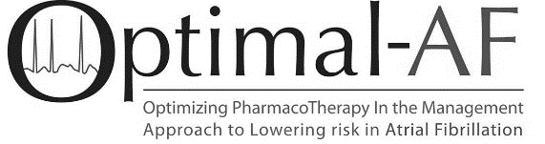
DOAC Dose and Lower Dose Concordance*
Apixaban (n=556⁺)
Dabigatran (n=181⁺)
Rivaroxaban (n=369⁺)
*Concordant with Health Canada Product Monograph prescribing recommendations
⁺Dosing information available
Non-vitamin K antagonist Oral Anticoagulant (NOAC) Use and Dosing in Canadian Practice: Insights from the Optimizing PharmacoTherapy in the Management Approach to Lowering risk in Atrial Fibrillation (OPTIMAL-AF) Program - CCS 2018 Poster Presentation
Notes:
Speaker Notes:
Of the 556 AF patients on Apixaban, 23% were given the reduced dose of 2.5 mg bid of whom about half (13% of the total) did not have 2 of the 3 “ABC” criteria present (age ≥ 80, weight ≤ 60 kg, creatinine ≥ 133)
Of the 181 patients on Dabigatran, 38% were on the reduced dose of 110mg bid and only 4% were felt to be on a dosage that was discordant with current Canadian Guidelines
Of the 369 patients on Rivaroxaban, 18% were on a reduced dose and 8% were felt to have been reduced to 15 mg daily inappropriately.
Overall, the message is that there is some room for improvement through further knowledge dissemination

Slide 20
What are real world data good for?
What are the real-world outcomes in patients receiving DOACs?
Notes:
Speaker Notes:

Slide 21
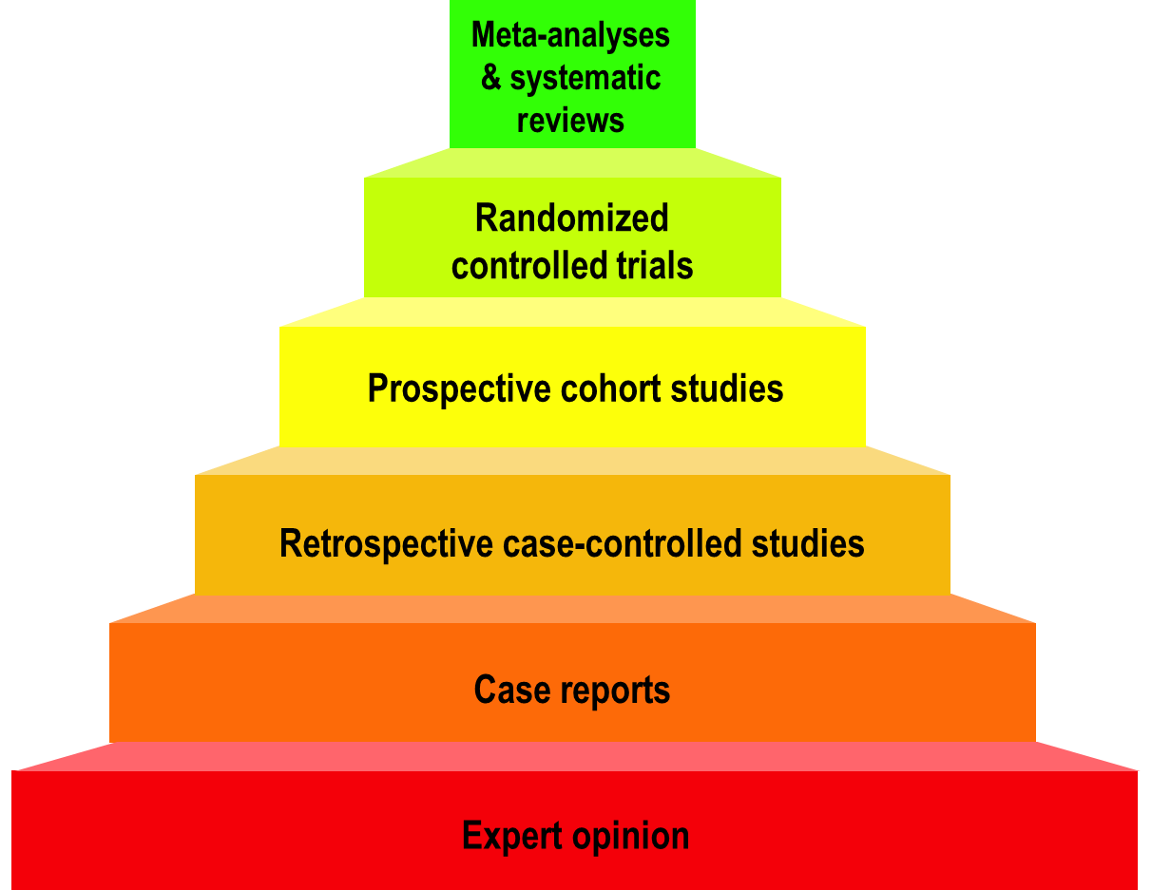
Hierarchy of Medical Evidence
Stronger
Observational
studies
Weaker
Modified from the logicofscience.com
Notes:
Speaker Notes:
It is important to emphasize that randomized controlled trials (RCTs) represent the strongest type of medical evidence to guide management of patients.
Observational studies vary on quality and can be confirmatory and reassuring when results agree with those of RCTs. When there is disagreement with RCTs, observational studies are considered “hypothesis generating” and findings need to be prospectively confirmed by randomized RCTs.

Slide 22

Not Medical Evidence
Patient wishes or testimonials
Celebrity endorsement
Experience with your last patient
Gut feeling
Familial instinct
Information from those who are biased
Modified from the logicofscience.com
Notes:
Speaker Notes:
This slide is self-explanatory and may be used at the speakers discretion to emphasize some of the many barriers we face in ensuring long-term patient compliance to DOACs in a world of “fake-news” and multiple different “opinions” from biased sources who often have a less than scientific personal agenda… Patients (and physicians..) must beware in a world of readily accessible (mis)information!

Slide 23
What are RWD Studies Good for?
Describe how the therapy is being used
Enable comparisons not available from RCTs
Describe outcomes in niche patient populations
Enable subgroup studies for individualized Rx
Unique observations generate hypotheses
Use large samples to identify rare events
NEVER to refute significant RCT findings
Modified from the logicofscience.com
Notes:
Speaker Notes:
This slide can be used to elaborate on comments made to slide 22 and list some of the potential uses of observational RWD studies.

Slide 24
What is “Propensity Score Matching”?
Doctors prescribe different treatments to different kinds of patients (patient characteristics determine their propensity to receive treatment X).
Propensity matching attempts to correct for this difference by matching patients in one group with patients in the other group based on the characteristics defining their propensity to be in one group rather than the other.
Does not correct for every propensity difference.
Modified from the logicofscience.com
Notes:
Speaker Notes:
This slide is useful when describing how non-randomized “big data” is used in Real World studies. Propensity score matching attempts to correct for the absence of prospective randomization when analyzing data retrospectively. Only variables that are available in the dataset can be matched and corrected for leaving plenty of room for unaccounted for bias. This is why propensity score matching can never be as powerful as prospective double blind randomization where groups are generally identical except for the variable (e.g. drug) under investigation.
May be used as a backup slide at the presenter’s discretion

Slide 25
RWD Studies Are Different
STRONGER REAL WORLD DATA | WEAKER REAL WORLD DATA
Prospective; purpose-specific data | Retrospective; convenience data
Propensity matched study populations | Unmatched study populations
Large patient populations | Small patient populations
Representative patient populations | Selected patient populations
Standard outcomes (same as the RCTs) | Unusual outcomes (different than RCTs)
Outcomes for efficacy and safety | Single sided outcomes
Follow-up durations long | Follow-up durations short
Funding independent of industry | Funded by industry
Analysis independent of industry | Analysis by industry
Sensitivity analysis for biases | No sensitivity analysis for biases
TEMPORAL TRENDS AND SAFETY | UNCOMMONLY HELPFUL
Adapted from Dang A, Kaur K. Perspect Clin Res 2016; 7(1): 9-14.
Notes:
Speaker Notes:
Slide compares the strengths and weaknesses of observational real world data, empowering the attendee to better discriminate between the growing number of RWD studies published each year.
Useful adjunct to slide 26 depending on the audience interest in the subject

Slide 26
DOACs as Compared to Warfarin Clinical Trials vs Real World Data (RWD)
 | Apixaban Aristotle Study¹ | RWD⁴ | Dabigatran RELY STUDY² | RWD⁴ | Rivaroxaban ROCKET STUDY³ | RWD⁴
Stroke/SE
Major Bleed
Intracranial Bleed
GI Bleed
All Cause Death
To To date there are no head-to-head trials between apixaban, dabigatran and rivaroxaban, therefore comparative efficacy and safety have not been established
Significant Increase
Significant Reduction
Non Significant Difference
Granger et al., NEJM 2011; 365: 981-992
Connolly et al., NEJM 2009; 361: 1139-1151
Patel et al., NEJM 2011; 365: 883-891
YAO et al. J Am Heart Assoc 2016;5:e003725
Notes:
Speaker Notes:
This slide shows some key efficacy and safety outcome data vs. warfarin from the three major new OAC trials: RE-LY, ROCKET and ARISTOTLE
Dabigatran 150 mg and apixaban 5 mg are associated with significant reduction of stroke/SE vs. warfarin.
Dabigatran 110 mg and apixaban 5 mg are associated with significant reduction of major bleeding vs. warfarin.
All new OACs are associated with a significant reduction of ICH compared to warfarin.
Apixaban is associated with significant reduction of mortality compared to warfarin.
Definition of major bleeding:
RE-LY: a reduction in the hemoglobin level of at least 20 g per liter, transfusion of at least 2 units of blood, or symptomatic bleeding in a critical area or organ.
ROCKET: as clinically overt bleeding associated with any of the following: fatal outcome, involving a critical site (i.e., intracranial, intraspinal, intraocular, pericardial, intraarticular, intramuscular with compartment syndrome, or retroperitoneal), or clinically overt bleeding associated with a fall in hemoglobin concentration of ≥ 2 g/dL, or leading to transfusion of ≥ 2 units of packed red blood cells or whole blood.
ARISTOTLE: clinically overt bleeding accompanied by a decrease in the hemoglobin level of at least 2 g per deciliter or transfusion of at least 2 units of packed red cells, occurring at a critical site, or resulting in death.
References:
﻿Connolly SJ, et al; for the RE-LY Steering Committee and Investigators. Dabigatran versus warfarin in patients with atrial fibrillation. N Engl J Med 2009; 361:1139-1151.
Connolly SJ, et al; for the RE-LY Investigators. Newly identified events in the RE-LY trial. N Engl J Med 2010; 363(19):1875-1876.
Patel MR, et al; and the ROCKET AF Steering Committee for the ROCKET AF Investigators. Rivaroxaban versus warfarin in nonvalvular atrial fibrillation. N Engl J Med 2011; 365:883-891.
Granger CB, et al; for the ARISTOTLE Committees and Investigators. Apixaban versus warfarin in patients with atrial fibrillation. N Engl J Med 2011; 365:981-992.

Slide 27
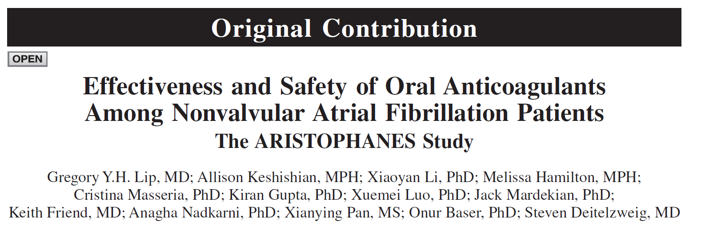
Stroke. 2018;49
DOI: 10.1161/STROKEAHA.118.020232.
The largest observational study on oral anticoagulants to date with 285,292 patients
Notes:
Speaker Notes:

Slide 28
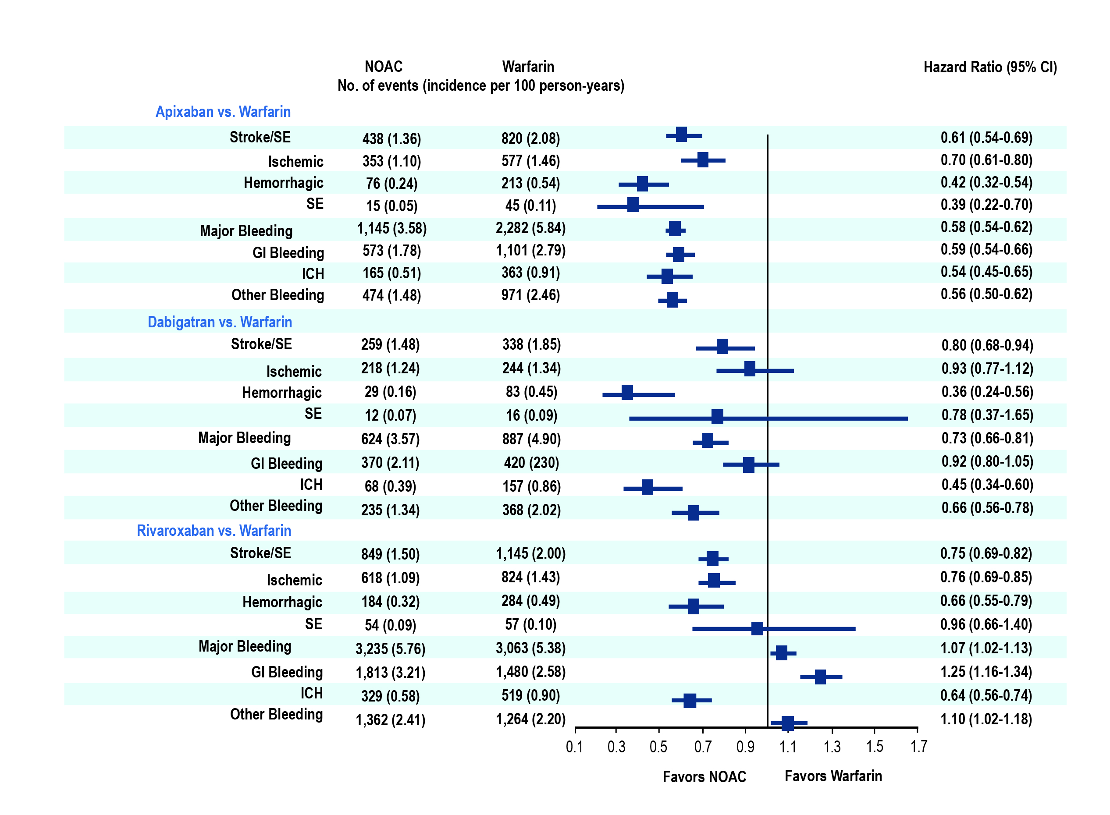
Main Analysis:
DOACs vs VKA
Stroke. 2018;49 DOI: 10.1161/STROKEAHA.118.020232
Notes:
Speaker Notes:

Slide 29
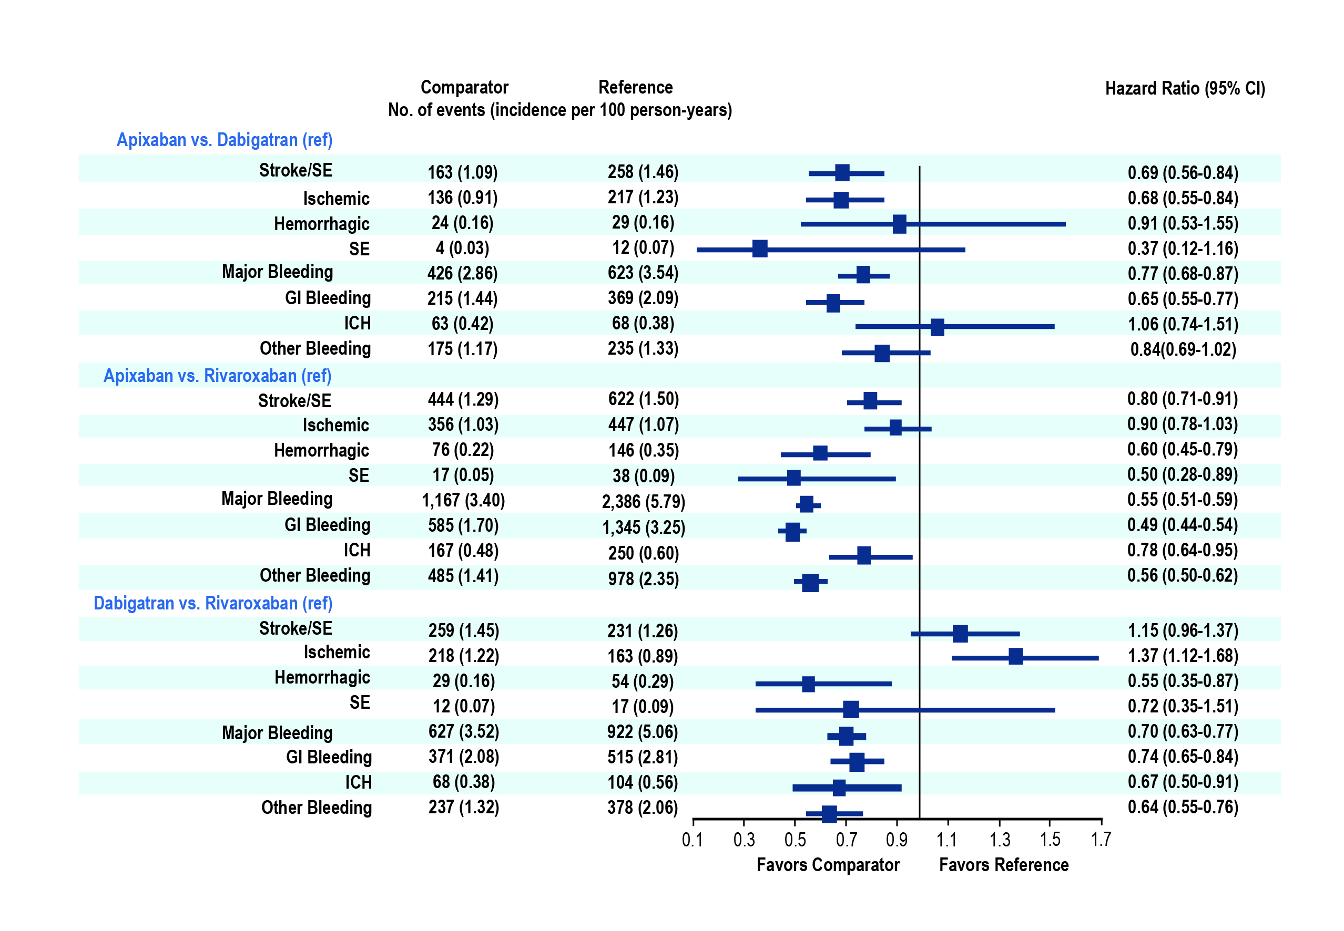
Main Analysis:
DOAC vs DOAC
Stroke. 2018;49 DOI: 10.1161/STROKEAHA.118.020232
Notes:
Speaker Notes:

Slide 30
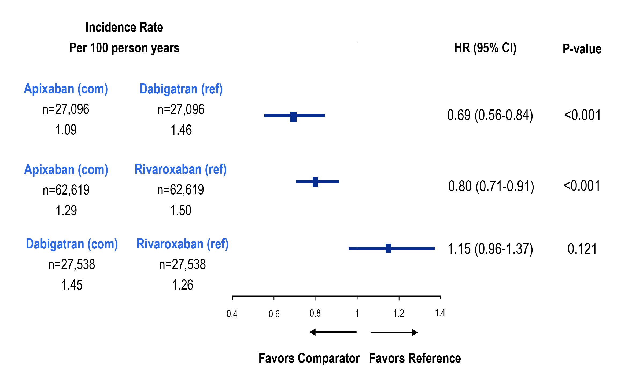
Propensity Score Matching-Adjusted Hazard Ratio of Stroke/Systemic Embolism
Each comparator cohort was independently propensity score matched against reference cohort. Therefore, comparisons cannot be made among the three separate matched cohorts of the analysis.
CI, confidence interval; com, comparator; HR, hazard ratio; PSM, propensity score matching; ref, reference; SE, systemic embolism.
Deitelzweig S et al. Poster presentation at ESC 2018, 25-29 August, Munich, Germany, poster P2567.
Notes:
Speaker Notes:

Slide 31
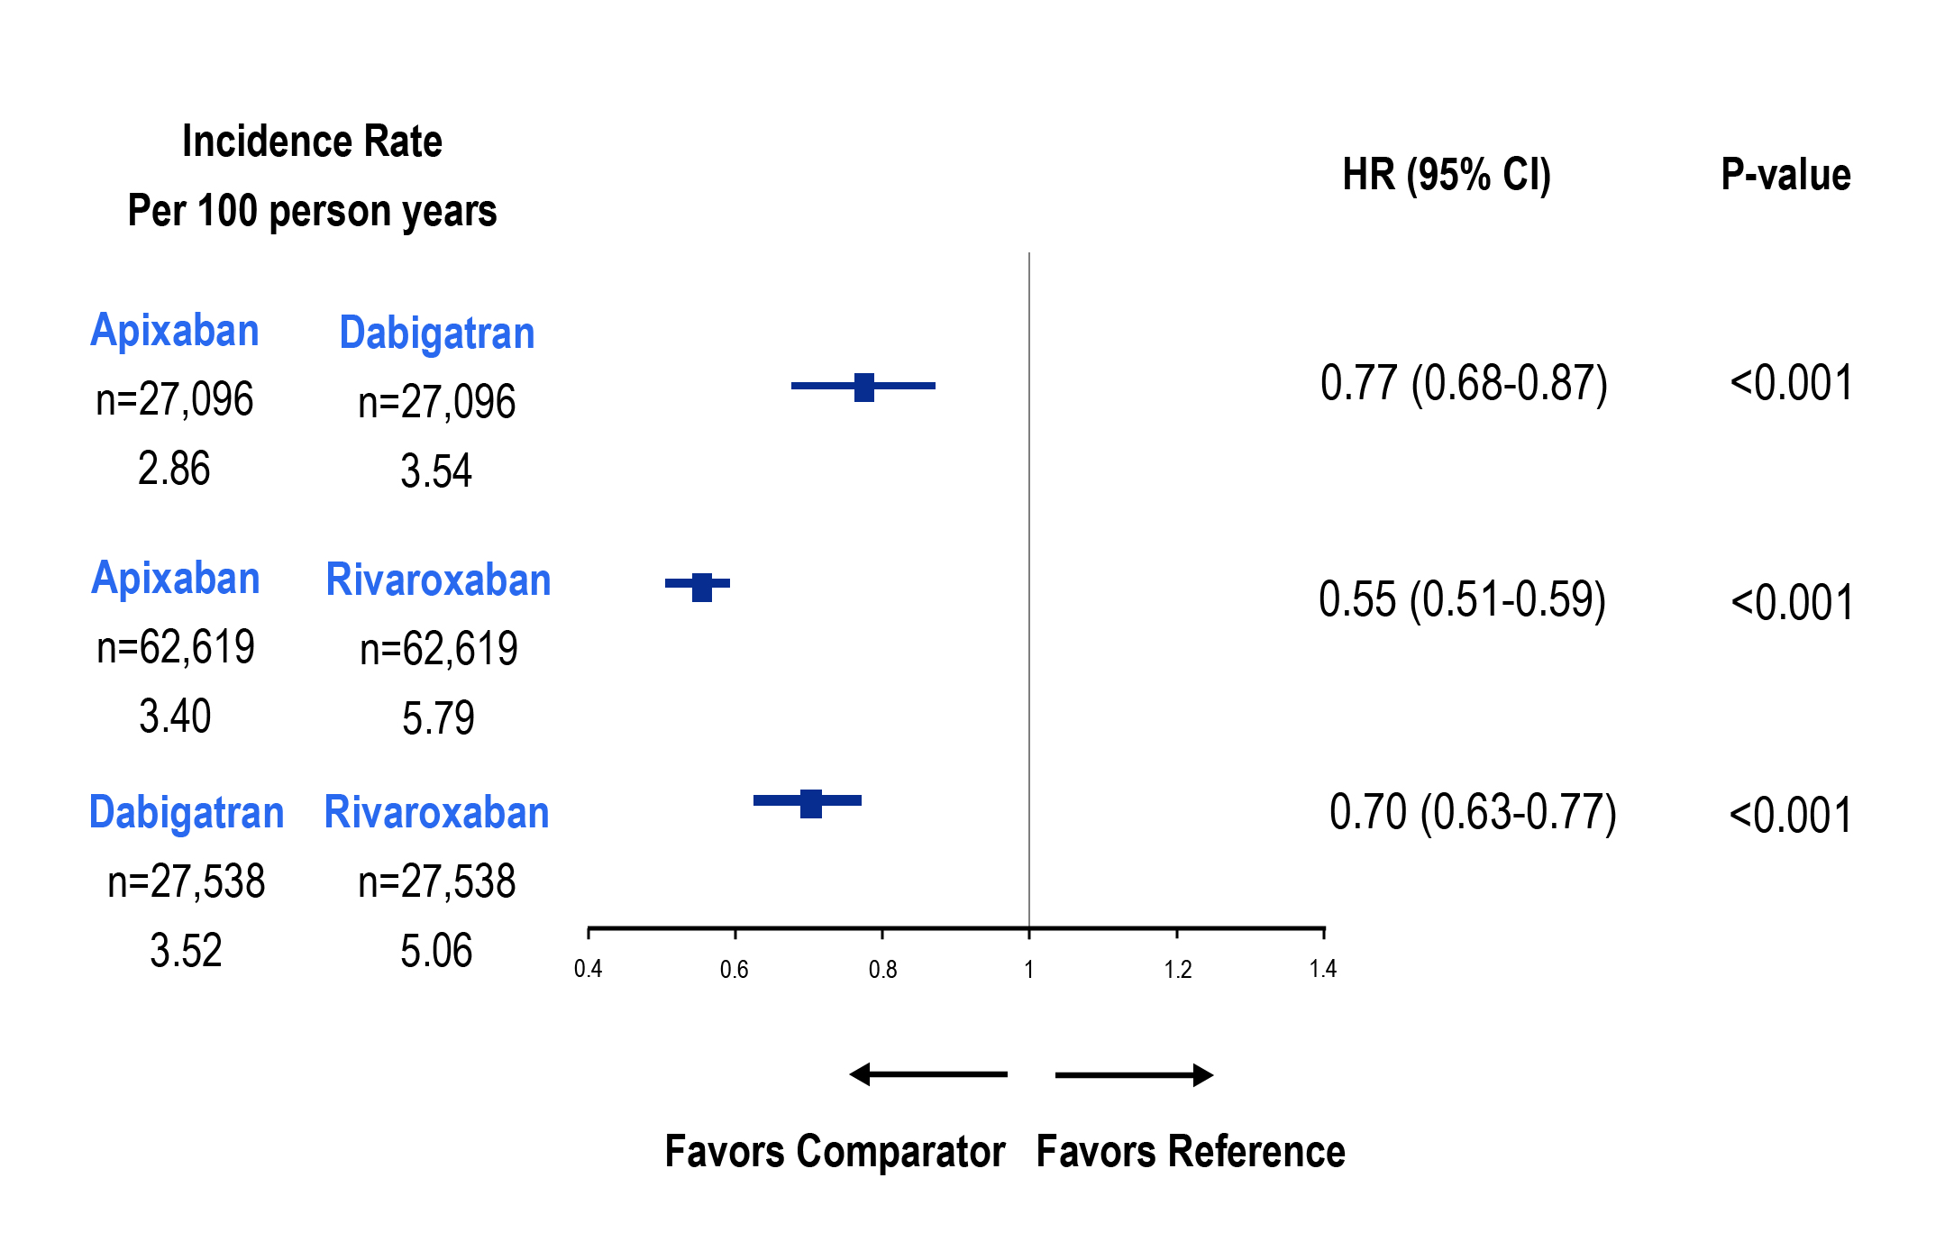
Propensity Score Matching-Adjusted Hazard Ratio of Major Bleeding
Each comparator cohort was independently propensity score matched against reference cohort. Therefore, comparisons cannot be made among the three separate matched cohorts of the analysis
CI, confidence interval; com, comparator; HR, hazard ratio; MB, major bleeding; ref, reference; SE, systemic embolism.
Deitelzweig S et al. Poster presentation at ESC 2018, 25-29 August, Munich, Germany, poster P2567.
Notes:
Speaker Notes:

Slide 32
Effectiveness and Safety of Dabigatran, Rivaroxaban, and Apixaban Versus Warfarin in Nonvalvular Atrial Fibrillation
Yao X, Abraham NS, Sangaralingham LR, Bellolio MF, McBane RD, Shah ND, Noseworthy PA
Yao et al. J Am Heart Assoc. 2016;5:e003725
Notes:
Speaker Notes:
Cohort Creation
Apixaban, dabigatran, rivaroxaban or warfarin users (10/1/2010-6/30/2015) N=1,873,941
12-month continuous enrollment N= 289,246 warfarin and N=83,084 DOAC
Patients with AF at baseline N=176,723
Exclude: valvular heart disease, ESRD/dialysis N=126,178
Final sample:
Dabigatran vs Warfarin (N=28,614)
Rivaroxaban vs Warfarin (N=32,350)
Apixaban vs Warfarin (N=15,390)
Propensity matching on 38 clinical variables

Slide 33
Apixaban vs. Warfarin
 |  | ARISTOLE Apixaban vs. Warfarin
 |  | HR (95% CI)
Stroke or systemic embolism |  | 0.79* (0.66, 0.95)
Major Bleeding |  | 0.69*** (0.60, 0.80)
Intracranial |  | 0.42*** (0.30, 0.58)
OLDW
Apixaban vs. Warfarin
HR (95% CI)
0.67* (0.46, 0.98)
0.45*** (0.34, 0.59)
0.24*** (0.12, 0.50)
*p<0.05, **p<0.01, ***p<0.001
Yao, Noseworthy JAHA 2016
Notes:
Speaker Notes:

Slide 34
Dabigatran vs. Warfarin
 |  | RE-LY Dabigatran vs. Warfarin
 |  | HR (95% CI)
Stroke or systemic embolism |  | 0.66*** (0.53, 0.82)
Major bleeding |  | 0.93 (0.81, 1.07)
Intracranial |  | 0.40*** (0.27, 0.60)
OLDW
Dabigatran vs. Warfarin
HR (95% CI)
0.98 (0.76, 1.26)
0.79** (0.64, 0.94)
0.36*** (0.23, 0.56)
*p<0.05, **p<0.01, ***p<0.001
†RE-LY results are from 150 mg; RE-LY used intent-to-treat analysis for safety outcomes
Yao, Noseworthy JAHA 2016
Notes:
Speaker Notes:

Slide 35
Rivaroxaban vs. Warfarin
 |  | ROCKET-AF Rivaroxaban vs. Warfarin
 |  | HR (95% CI)
Stroke or systemic embolism |  | 0.88 (0.75, 1.03)
Major Bleeding |  | 1.04 (0.90, 1.20)
Intracranial |  | 0.67* (0.47, 0.93)
OLDW
Rivaroxaban vs. Warfarin
HR (95% CI)
0.93 (0.72, 1.19)
1.04 (0.90, 1.20)
0.51*** (0.35, 0.75)
*p<0.05, **p<0.01, ***p<0.001
Yao, Noseworthy JAHA 2016
Notes:
Speaker Notes:

Slide 36
What are the other implications of a Once-Daily versus Twice-Daily DOAC?
Notes:
Speaker Notes:

Slide 37

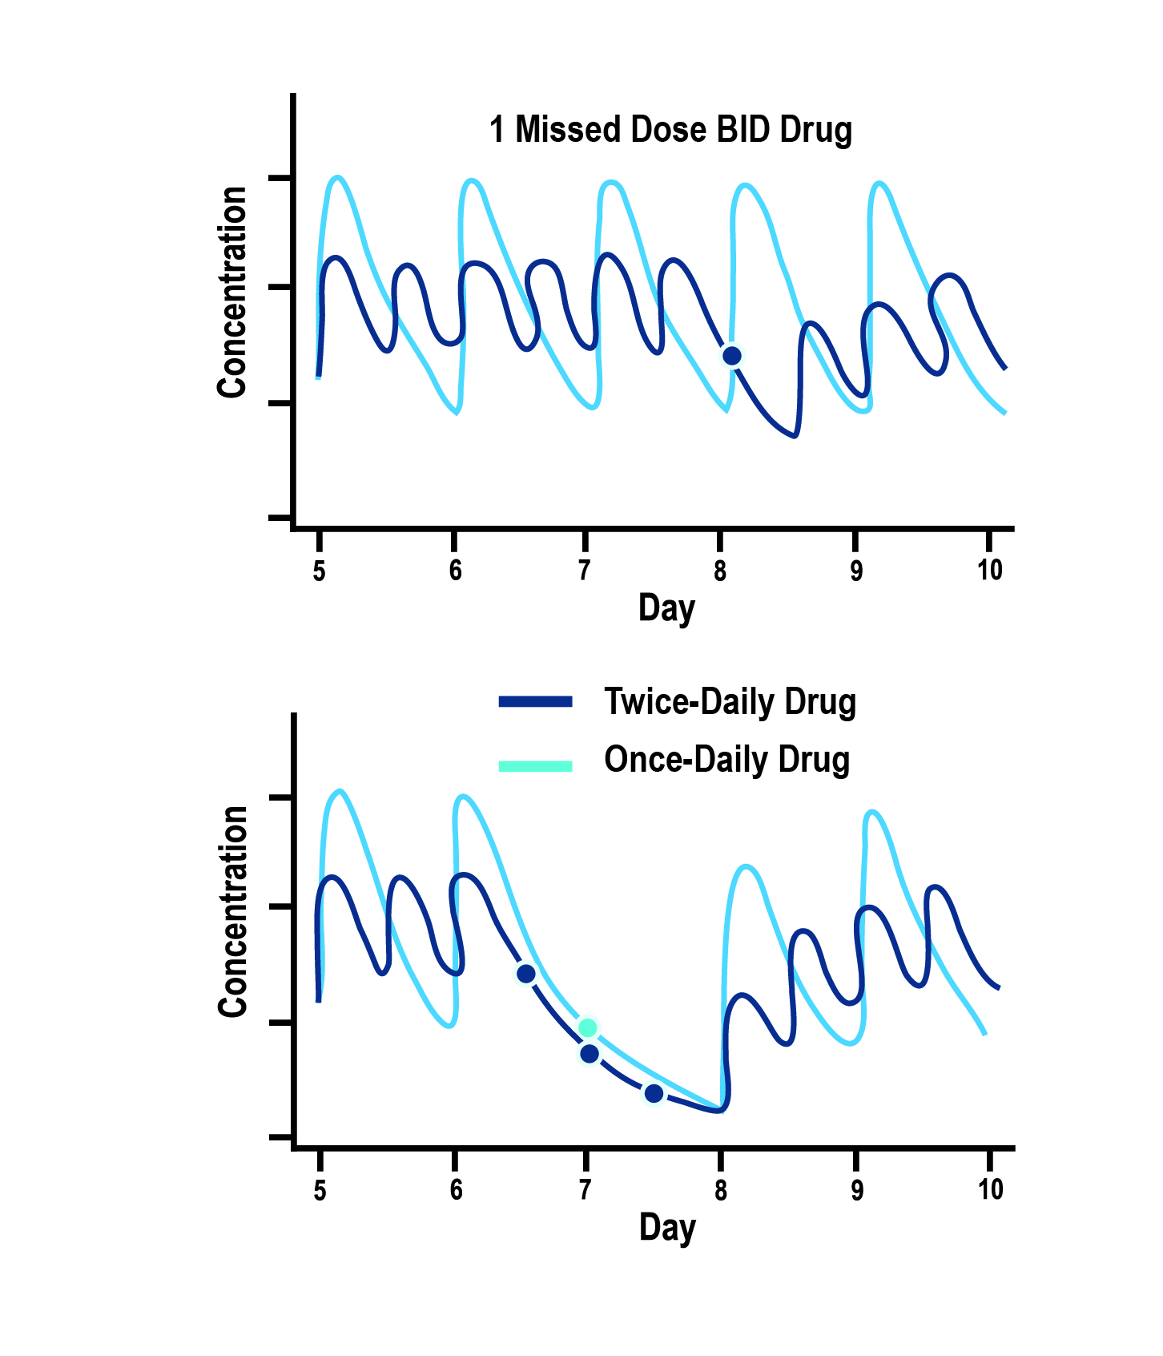
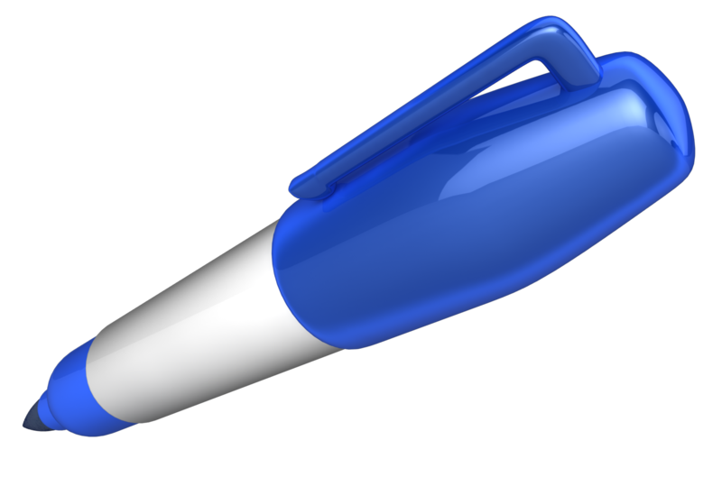
Dosing Considerations and Implications of a Single Missed Dose
Dosing also has implications on the impact of a single missed dose.
One missed dose of QD drug ≠ One missed dose of BID drug
1 missed QD dose equals 3 missed BID doses
Comparative effects of prescribing the same total daily dose, given either once-daily (QD) or as half-strength twice-daily (BID) doses, for the same drug, or 2 drugs with identical pharmacokinetic parameters:
Twice-daily dosing regimen is less prone to high peaks or low troughs in anticoagulant concentrations and associated actions.
Disproportionately greater impact on drug action of skipping a once-daily than a twice-daily dose
Vrijens B, Heidbuchel H. Europace. 2015 Apr;17(4):514-23.
Notes:
Speaker Notes:
From a pharmacodynamics standpoint for DOACs with a short 12 hour half-life, missing a dose of a once-daily drug exposes to patient to a period of relative under-anticoagulation and risk of stroke/SE. By the time the next dose is taken, 48 hours (or four half-lives) have potentially elapsed and only 12.5% of the DOAC remains in the system.
A patient would have to miss three consecutive doses of a DOAC taken twice-daily for an equivalent risk exposure. Being on a once-daily DOAC may therefore not be an advantage for a forgetful patient who frequently misses doses as he/she is less likely to miss three consecutive doses of medication.

Slide 38
What does persistence with DOACs look like?
Notes:
Speaker Notes:

Slide 39
Discontinuation Rates from Randomized Clinical Registration Trials
Frequency treatment discontinuation in phase 3 trials.
Odds ratios and 95% confidence intervals (CIs) were calculated from the reported event frequencies
Studies Estimate (95% CI)
RELY 150 mg BID 1.358 (1.234, 1.494)
RELY 110 mg BID 1.413 (1.285, 1.553)
ROCKET-AF 20 mg OD 1.088 (1.006, 1.177)
ARISTOTLE 5 mg BID 0.893 (0.836, 0.954)
ENGAGE-AF 60 mg OD 0.999 (0.932, 1.071)
ENGAGE-AF 30 mg OD 0.935 (0.872, 1.003)
1.094 (0.949, 1.261)
Komocsi A. Curr Med Res Opin. 2015; 31(10):1841-4.
Notes:
Speaker Notes:
Methods: The authors analyzed treatment discontinuation frequencies in phase 3 trials of anticoagulant treatment in non-valvular atrial fibrillation in a frequentist random effect metaanalysis and in Bayesian multiple treatment network comparison.
Results: Frequency of discontinuations are heterogeneous and highly inconsistent Discontinuations were the most frequent with dabigatran followed by rivaroxaban, warfarin, edoxaban and apixaban.
Rivaroxaban were less frequently discontinued when compared to the two doses of dabigatran. (OR 0.80; 95% CI: 0.71–0.91 versus 150 mg b.i.d., and OR: 0.77; 95% CI: 0.68–0.87 versus 110 mg b.i.d.).
Conclusion:
Important differences exist among the treatment adherence of different anticoagulant protocols. Discontinuation rates experienced during the clinical trials may predict the real life patient persistence

Slide 40
Mayo Clinic Real World Data Analysis
of Non-Adherence
Mean age 73 yrs (IQR 64-80 yrs); 56% male
89.6% had CHA₂DS₂-VASc ≥2, 47.8% had HAS-BLED ≥3
Compliance defined as ≥80% of days covered by OAC
Adjusted for potential confounders
52.1
47.6
45.9
Compliance (%)
38.7
Apixaban
Rivaroxaban
Dabigatran
Warfarin
Yao X et al. J Amer Coll Cardiol 69:2779-90, 2017
Notes:
Speaker Notes:

Slide 41

Key Messages
AF is a common and important cause of stroke and needs to be rigorously ruled out in idiopathic stroke
Appropriate anticoagulation treatment should be started when indicated in the vast majority of AF patients as per the 2018 CCS guidelines
DOACs offer several advantages over warfarin, and should generally be used in preference to warfarin for SPAF as per 2018 CCS guidelines
Risk of bleeding should be modified where possible but very rarely outweighs the risk of stroke
Patient characteristics and co-morbidities (age, renal function, etc) should be considered when selecting and dosing DOACs
Real world evidence provides reassurance of the efficacy and safety of DOACs in SPAF but highlights the challenges of correct dosing and compliance
Notes:
Speaker Notes:
Most patients with AF and CAD who are eligible for OAC according to CHADS-65 end up on a DOAC alone after 12 months of CAD “stability”, defined as no ACS or need for revascularization (PCI or CABG).

